Slide 1
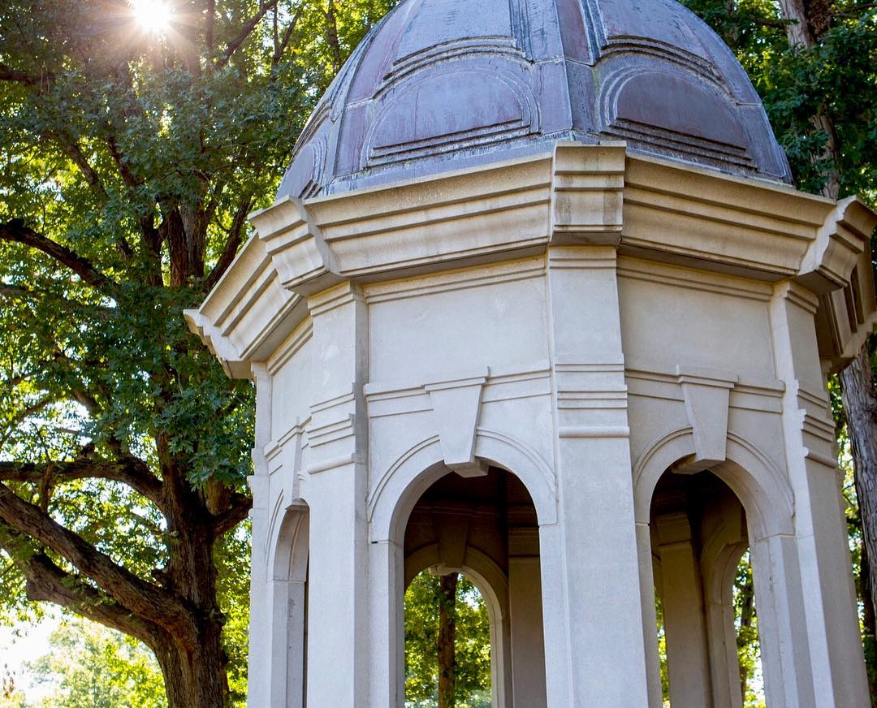
ALEKS & College Algebra -
A Journey to Finding the Best Model:
Presented by: April Talbert
February 8, 2019

Slide 2
The Traditional Approach
Students meet with instructor 3 hours a week in classroom
Homework (paper and/or computer based) assigned and completed outside of class
Students go to instructor’s office hours for help
Common minimum content in all courses
Instructors make their own course materials (test, syllabus, etc.)
Common final exam
Fall ABC Rate- 63%
Spring ABC Rate- 50%

Slide 3


Slide 4
Redesign – Hybrid Emporium Model
Mandatory attendance policy for first day of class
Students meet with instructor one day a week for 50 minutes in classroom
  In class - instructor covers difficult concepts and examples (common course pack)
Students spend a minimum of 3 hours each week in CAVE (tracked using AccuSQL)
  In the CAVE - students work on course assignments with tutors available to provide assistance as needed
Common course materials (syllabus, course pack, online homework, etc.)
Common tests and common final completed in CAVE
Fall ABC Rate – 66%
Spring ABC Rate – 63%

Slide 5
New Model with ALEKS
Mandatory attendance policy for first day of class
  First day of class - Instructor covers important course policies, helps students register for ALEKS, and students complete the initial knowledge check
Students meet with instructor one day a week for 1 hour and 50 minutes in the CAVE
  In class – Instructor starts class with important announcements and then provides mini lectures to groups of students. Students not participating in a group continue working on their path in ALEKS with tutors present to provided help as needed.
Weekly CAVE hour requirement is based on performance in course. In general a minimum of 1 hour is required unless a student meets one of the below criteria:
  If student’s overall grade in ALEKS is a 0%-69%, then at least 2 CAVE hours are required each week
  If a student earns a 0%-69% on Test 1, then at least 2 CAVE hours are required each week
  If a student earns a 0%-69% on Test 2, then at least 2 CAVE hours are required each week
Common tests and common final completed in CAVE during class time

Slide 6
Incentives to Encourage Student Success
Gold Option
Purple Option
Class attendance optional and CAVE hours optional
How to qualify:
  If after completing Test 1, your Test 1 score AND your overall grade in ALEKS is a 93.00% or higher, then you qualify.
  If after completing Test 2, your Test 2 score AND your overall grade in ALEKS is a 93.00% or higher, then you qualify.
If at any time your overall grade in ALEKS drops below a 93.00%, then you will then return to the normal schedule and will no longer be eligible for this option
Class attendance required and CAVE hours optional
How to qualify:
  If after completing Test 1, your Test 1 score AND your overall grade in ALEKS is a 87.00% or higher, then you qualify.
  If after completing Test 2, your Test 2 score AND your overall grade in ALEKS is a 87.00% or higher, then you qualify.
If at any time your overall grade in ALEKS drops below an 87.00%, then you will then return to the normal schedule and will no longer be eligible for this option.

Slide 7
Results
Fall ABC Rate
Spring ABC Rate
Year | Overall | Pilot
2016 | 65% | 63%*
2017 | 66% | 72%
Year | Overall | Pilot
2017 | 65% | 79%
2018 | 74% | 83%

Slide 8
Essentials for Redesign Success
Support from administrations
Support from advisers
Support from faculty
A director or course coordinator (2 course release for duties per semester)
Excellent communication

Slide 9
Other Initiatives
2018 Summer Bridge Program
2018-2019 Co-Remediation
Online program in ALEKS to help students remediate and prepare for placement test.
Any student can self-select to participate
331 participants
262 took placement test
86 passed
Students enroll in both remedial math and College Algebra during the same semester
Remedial Math- meets on Tuesdays and Thursdays in classroom
College Algebra- meets on Wednesdays in CAVE and follows new approach with ALEKS (class is a mixture of remedial students and non remedial students)

Slide 10
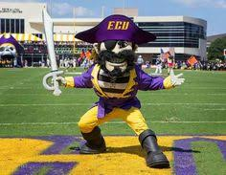
Questions
April Talbert
talberta16@ecu.edu

