Slide 1

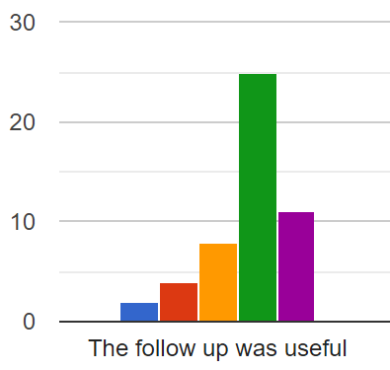
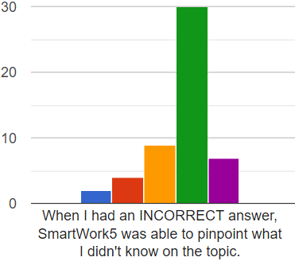
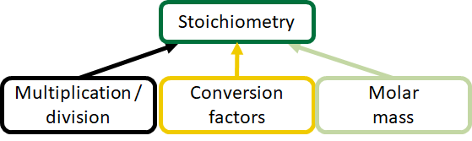
Implementation of Pre-Course Adaptive Technology for Individual Chemistry Mastery
Susan K. Michael and Richard L. Jew
Department of Chemistry, University of North Carolina at Charlotte
Introduction
CHEM 1251 (General Chemistry I) is a large enrollment course that serves a variety of STEM majors. Educational technologies have been incorporated to maintain standards, across sections, and to individualize questions for students. Adaptive technologies personalize not only the values used in a problem type for students, but also the order and process of multiple problem types to achieve mastery. Here, we report our findings from the use of adaptive assignments, in the summer prior to the start of a course, to tailor the learning pathways of students with disparate backgrounds to master learning objectives essential to success.
Methods
Setup and Timelines
Experimental group was CHEM 1251-001, taught by S. Michael
Control groups were CHEM 1251-005, taught by S. Michael, and all other CHEM 1251 sections
Starting in July, students were contacted weekly, as they enrolled, to sign up for and complete the SmartWork pre-semester assignment
Pre-semester assignment was weighted at two homework assignments, and was due 3 days after the Add/Drop date (10 days into the semester)
Assignment Details
The main learning objectives that were most critical to future success in CHEM 1251 were determined
For each learning objective, a set of questions were selected. If mastery was not achieved through this set of questions, the adaptive follow-up was issued until mastery was demonstrated.
Learning objectives included mathematical (EG) and chemical (EG) topics
Assessments
Compared exam scores and DFW numbers for sections 001 (170 students) and 005 (173 students)
Compared exam scores and DFW numbers for section 001 versus all other sections
Collected attitudinal survey results from students; survey was issued after midterm grade reports
Discussion
Positive Outcomes
Majority of student responses were neutral to favorable regarding both the system and the benefit of the assignment
The most positive responses noted that the program identified their deficiencies in knowledge
Students who completed 80% or more of the Adaptive Follow-Ups were more likely to score above the class average, while those who only completed 70% or less scored at or below the class average
Two students recognized their deficiencies and registered for CHEM 1200 instead of CHEM 1251.
Negative Outcomes
12% of respondents found the assignment unfavorable; this cohort was composed of very high and very low performing students only
Instructor time to create modules and contact students every week to motivate working students and encourage others to start
Received parental pushback against pre-semester workload
Difficult to know how “much” work constituted mastery in SW5
Low performing students lost confidence in their abilities
Impediments to Analysis
Only 49 survey respondents out of 170 students
Only 18 students out of 170 completed all modules before the first day of classes
Some students switched sections, before classes began, to avoid participation in the assessment
Goals
Adaptive Technologies:
To tailor difficulty for each student
To help students address their specific deficiencies
To build confidence and competence in linearly-stacked learning objectives
To identify prerequisite learning objective deficiencies and remediate
Pre-Semester Preparatory Assignment:
To align incoming students’ chemical, mathematical, and problem solving fluency to a common, base level
To establish time-on-task expectations for university courses
To review and refresh topics from prior chemistry courses
To point students to the correct course in a linear sequence to maximize success
Conclusions
Students who completed 80% or more of the Adaptive Follow-ups were more likely to score above the class average on exams.
Very high and very low performing students had negative opinions about the pre-semester assignment, which contributed to lower confidence about their ability to succeed.
Like all other educational technologies, adaptive technologies will have machine compatibility and software stability issues.
Adaptive Follow-Ups did help identify student’s deficiencies in knowledge, which may aid them metacognitively.
Adaptive technologies that have been tested work best if there are only a limited number of learning objectives.
Students in another section scored equally well as students who took the pre-semester assignment, suggesting that other facets of the course experience (instructor, problem session style, time of day) may comprise a successful collection of approaches.
History
1251 is a large enrollment course for all STEM and pre-health majors with enrollments of ~1100 students in the Fall semester.
Prerequisites are either MATH 1100 (College Algebra) or CHEM 1200 (Fundamentals of Chem.); no current placement exam.
Other educational technologies include LMS-based course webpages, pre-lecture videos and assignments, in-class response systems, and electronic homework.
2 x 75 minute meetings or 3 x 50 minute meetings, plus an instructor-led problem session or undergraduate-led discussion sections (TASL).
Adaptive Techologies previously used in Fall 2010 (ALEKS for homework), Fall 2017-Spring 2018 (MasteringChemistry/Knewton for pre-Exam Prep), and Spring 2018 (SmartWork for homework in 1252).
Data
Performance: Section 001 vs. Section 005
DFW: 37.7% (001), 44.51% (005)
Exam average at midterm: 68.32% (001), 65.90% (005)
Performance: Section 001 vs. all CHEM 1251 Sections
Exam average at midterm: 68.32% (001), 67.45% (other)
Student Attitudes to Adaptive System and Content
49 respondents: Agree (A), Neutral (N), Disagree (D)
Trusted System to ID Mastery: 53.1% A, 22.5 N, 18.4% D
SW5 found knowledge gaps: 69.4% A, 18.4% N, 12.2% D
Can’t find find background info: 44.9% A, 26.5% N, 26.5% D
Acknowledgments
Kristin McDonald and Christine Pruis, W.W. Norton
Dave Franztreb, Office of Undergraduate Education, UNCC
Bernadette T. Donovan-Merkert, Dept. of Chemistry, UNCC
Department of Chemistry
Center for Teaching and Learning, UNCC

