Slide 1
Adaptive Learning Platform for Engineering Dynamics
February 8, 2009 Matt Davies, Tyler Blankenship, Raj Shanmugam, Glen Smith

Slide 2
This talk describes the early implementation of an Adaptive Learning System in Engineering Dynamics/System Dynamics in Mechanical Engineering at UNC Charlotte using the RealizIT system.
Organization
What is Engineering Dynamics/System Dynamics?
Why did we choose Adaptive Learning?
Partners
Course Development and Implementation
Module development
Integration of software tools
Preliminary results of the pilot implementation
Conclusions and next steps

Slide 3
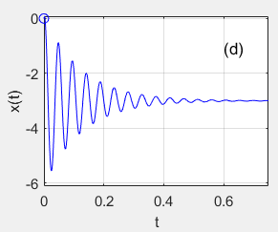
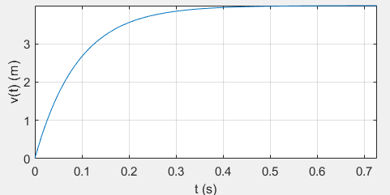
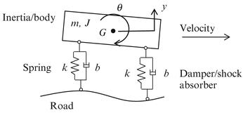
Engineering Dynamics is a core junior level course in engineering curricula that teaches the fundamentals of dynamic modeling of engineering systems with differential equations.
Mechanical engineering applications: Vehicle suspensions, Aircraft/spacecraft control,
Robotics, Manufacturing, …
Topics: Mechanical oscillators (linear/rotational), Electric circuits, Motors, Generators,
Thermal Systems, Fluidic systems, …
Mathematical underpinnings: Linear Differential Equations
Engineering Systems
Dynamic Models
Typical Types Dynamic Behavior
Typical Types Dynamic Behavior
Non-oscillatory
Oscillatory
$$\ddot{x}+2ζω_{n}\dot{x}+ω_{n}^{2}x=g(t)$$
https://www.youtube.com/watch?v=_SPflUyT1rQ

Slide 4
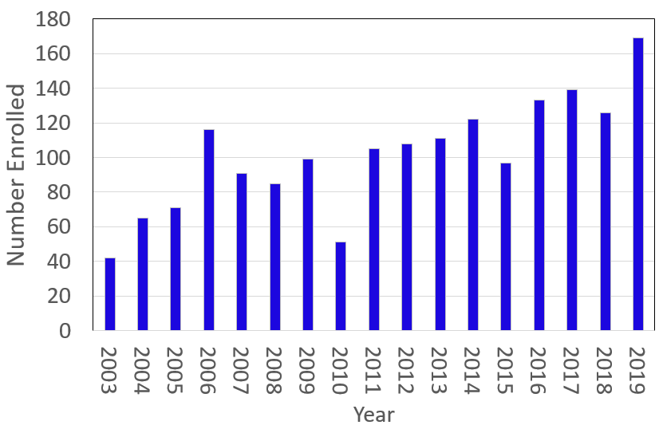
We chose Adaptive Learning for this course because it: (1) requires practice of mathematical tools and problems amenable to randomization; and (2) traditional methods break down for large classes.
Why Adaptive Learning?
Rapid Growth
Large Classes
Fall 2003 – One section (42)
Fall 2019 – One Section (124)
Previous Feedback
Not enough practice problems
Students work together
Homework grading time
Inconsistent Mathematical Background
Fundamental Math Content (Accreditation Requirement)
No longer works here!
What was developed here
Enrollment Growth MEGR 3122

Slide 5
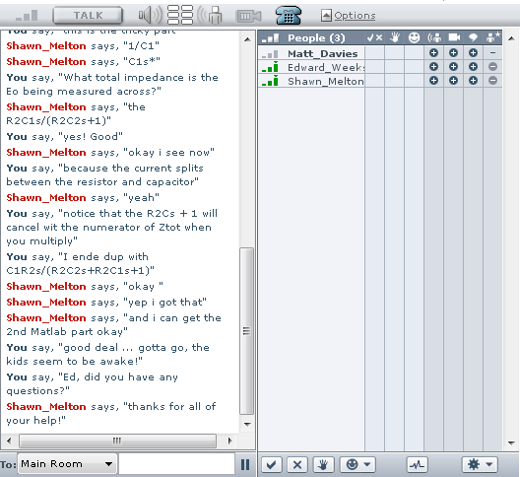
The previous model was traditional with some less traditional twists to personalize the experience for the student.
Previous Model
16 weeks
25 Traditional Lectures (two 1.25 hour/week)
3 In-class Exams
Graded by professor
12 Written Homework Assignments
Graded by TA
Personalized Attention (2003-2010)
Chatroom help (9 pm)
Partial In-class/take-home exams
Class Improvement Committee
In-Person Exam Review Sessions with Pizza! ($Cost =\$13×\left[\frac{1}{8}(2×125)\right]=\$136. 5$0)
Bandages (2010-2018)
Video lecture help
Homework videos
No more pizza ($Cost =\$13×\left[\frac{1}{8}(2×125)\right]=\$406.25$!)

Slide 6
The previous model was traditional with some less traditional twists to personalize the experience for the student.
Intermediate Model
16 weeks
42 Traditional Lectures (three 50 min per week)
3 In-class Exams
Graded by professor
4 RealizIT Assignments (Fundamental Mathematics)
Evaluated in RealizIT (no grading)
More Virtual Personal Attention
8 Traditional Assignments
PDF
Graded by TA
Evaluations
Student feedback
Exam 1 performance
Assignment response rate

Slide 7
In implementing the system, we “interviewed” three companies.
Requirements
Target: Replace Homework Spring 2019
Fairly high level of content
Differential Equations
Willingness to implement other tools
Free-Body Diagrams
MATLAB Programming
Physical demonstrations (Applets)
Demonstration of ability to handle other higher level engineering courses
Time and labor requirements
Professor Matt Davies
20 hours/week Summer 18, Fall 18
Undergraduate Tyler Blankenship
40 hours per week S18
20 hours per week F18 & S19
Graduate Student Raj Shanmugam
10 hours per week F18
Graduate Student Glen Smith
20 hours per week S19
Initially, we went out on our own not knowing what we didn’t know! We got quotes ~ $20,000 and then connected with CTL.

Slide 8
The implementation went in stages beginning with a mapping of the course structure in Modules, Nodes and Objectives.
A node is a concept (approximately two per lecture)
An objective maps to a homework with four in the first third of the course
A module relates to a particular type of physical system (e.g. electric circuits)
Objective
Module
Node

Slide 9
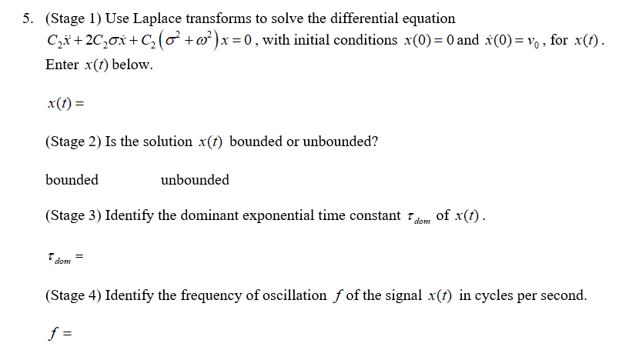
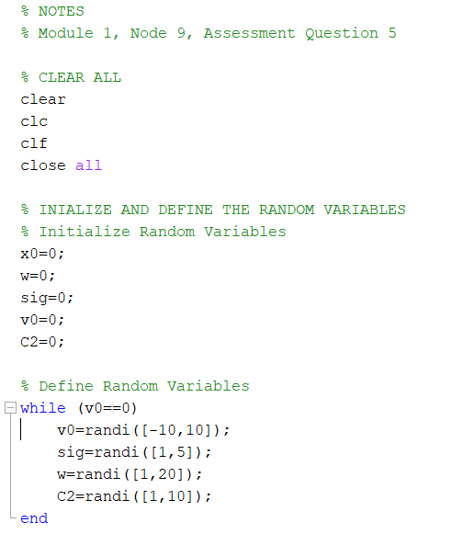
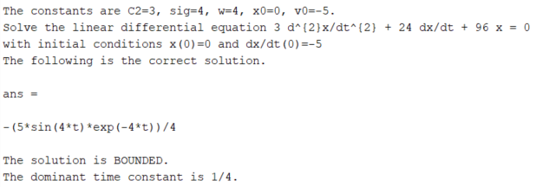
Questions were painstakingly developed with random inputs and solutions that were tailored to each student’s problem.
Answers should be tractable
Questions should have mathematically correct and physically meaningful values
The devil is in the details!
Each problem has: (1) definition in MS Word; (2) MATLAB check; (3) definition in RealizIT
Extensive testing in MATLAB first, then RealizIT

Slide 10
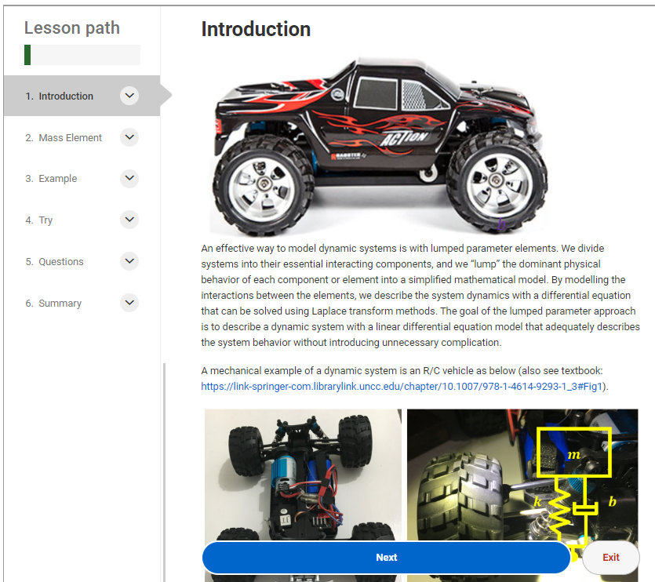
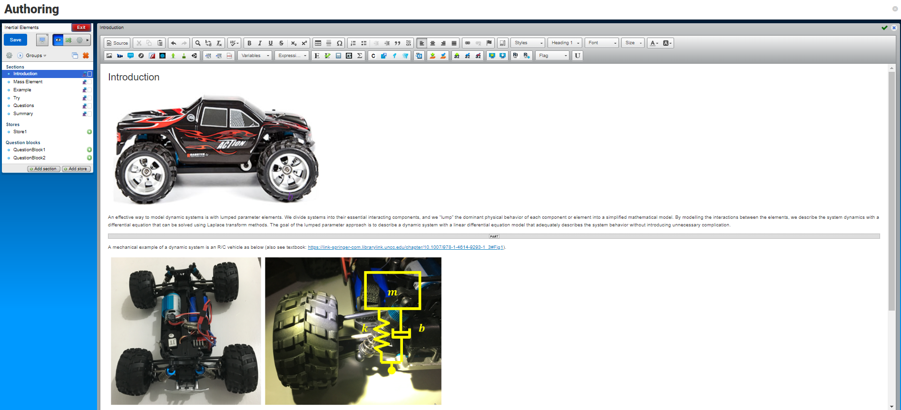
Lesson content was authored in collaboration with RealizIT and required significant website development and collaboration.
Authoring to final product and testing …

Slide 11
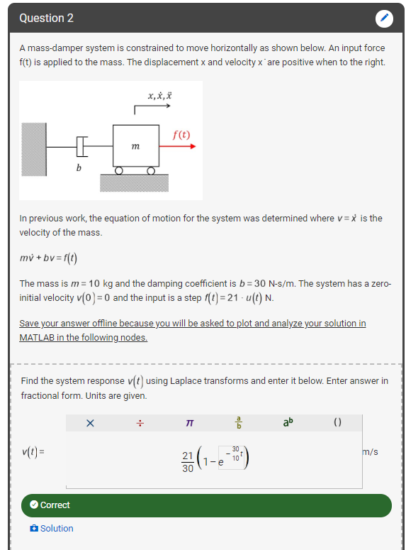
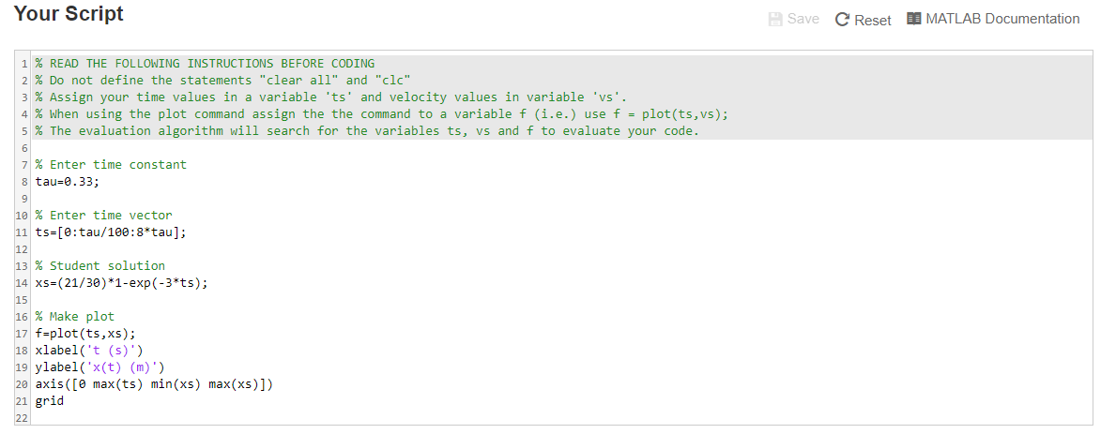
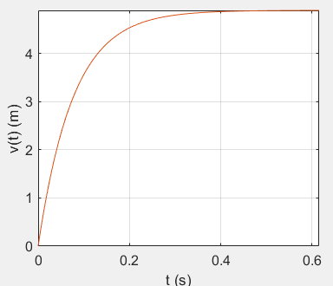
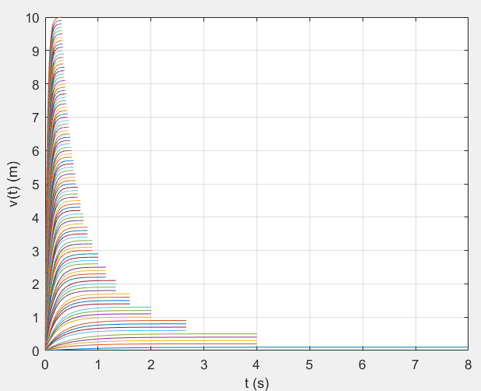
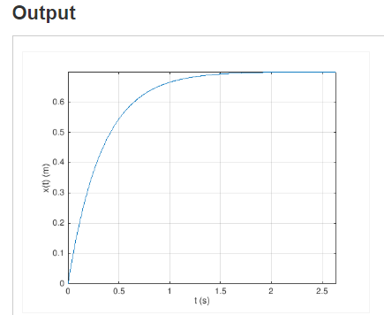
MATLAB Grader was implemented with a “tricky” method of communication to/from RealizIT.
Students required to us MATLAB to plot and analyze solutions
Problem – Passing random numbers between RealizIT and MATLAB grader for every problem is difficult
Solution – Generate many known combinations of parameters and have MATLAB grader check ever submission against all possible cases
2. Student plots their solution in MATLAB Grader
Behind the scenes – MATLAB checked student solution against 100 possible solutions!
1. Student solves problem in RealizIT with delivered parameters
Match Solution Number 83
Check
Student Solution
3. Student submits solution in MATLAB Grader

Slide 12
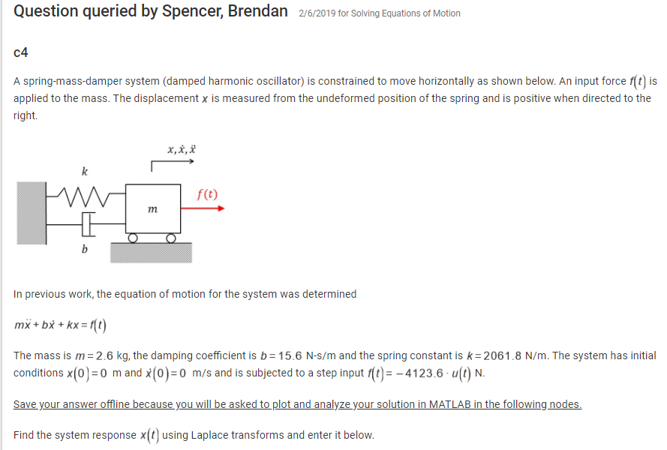
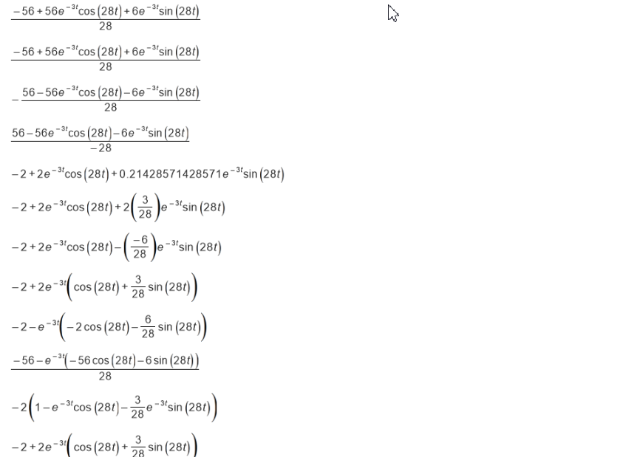
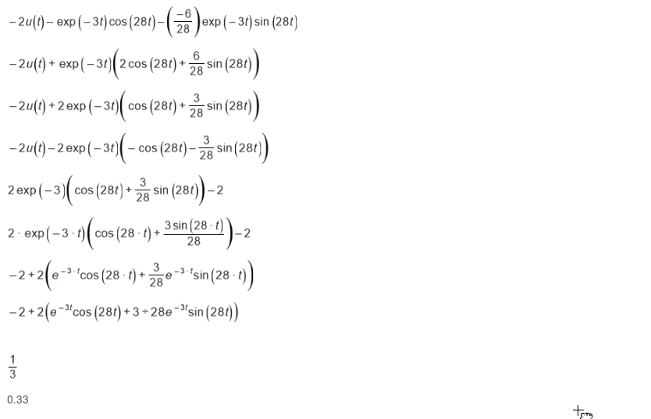
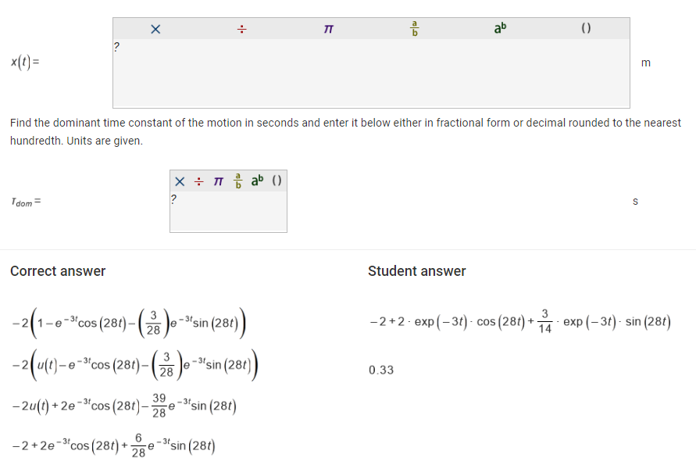
While our goal was to implement all homework in RealizIT by Spring 2019, we instead implemented the most important first third of the course with plans to finish in Summer 2019 and test again in Fall 2019.
Question development and queries were more challenging than anticipated
Lastname, firstname

Slide 13
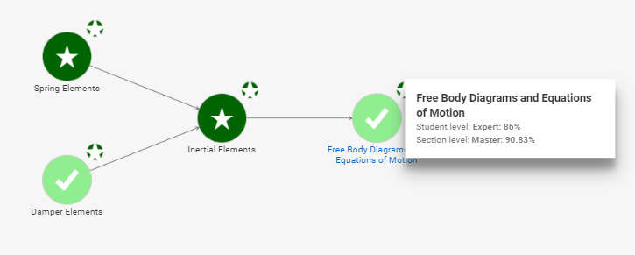
Real time feedback on student performance changed the lecture content substantially but is not leading to a flipped classroom (yet!).
Debugging and student queries is a challenge! There were 104 (mostly legitimate) queries in objective 3.

Slide 14
Student feedback thus far …
“I like that I can receive live feedback with a full solution for problems
that I get wrong which helps me improve throughout the assignment.”
“The structure of the class has made it one of the best engineering
classes I have ever attended.”
"The RealizIt system is extremely helpful in enhancing my learning of
Dynamics. Although it does take more time than other forms of learning,
I feel like my knowledge of the topics for this class wouldn't be as high if
I wasn't using this system. It gives me the ability to pace myself which is
great especially since I have a busy schedule. I wish other classes had
something like this."
“Realize IT is a great learning tool to learn new material but the only draw back is the
amount of error that the program has when inputting answers.”
Great start. Debugging of content is still needed and is occurring continually.

Slide 15
Concluding comments and future work.
We have implemented approximately one-third of the course with very positive feedback from the students.
Implementation has been challenging with 124 mechanical engineering juniors
We alpha-tested questions in MATLAB and with 5 students, but there are many possible ways things can go wrong
Legitimate question faults are few but even one generates a large number of queries
At this level, the questions require a lot of debugging and that can’t be done without beta-testing on real students
Need a more efficient method of testing algebraic permutations – one question may have 50 different correct ways to write the answer!
Quantitative evaluation: Exam 1 performance, homework turn-in rates
Next steps are to implement 7 more modules and test again in Fall 2019 with a smaller section.

